Slide 1

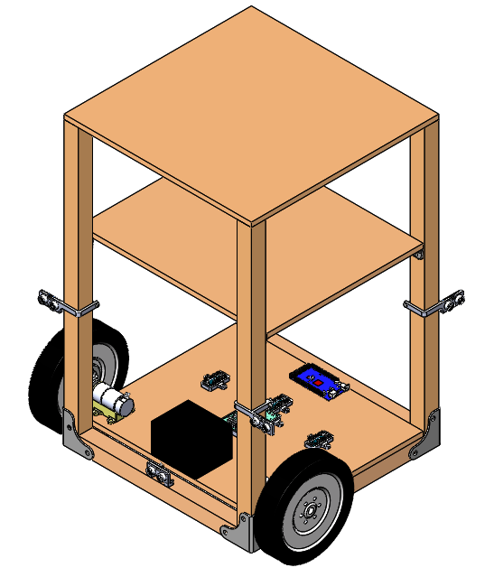
Design and Prototype of an Autonomous Shopping Cart
Siddharth Kurwa
Faculty Advisor: Dr. Carolyn Seepersad
Background
Control System Design
Disturbance
+
+
PID
Left Motor
+
-
-
Proximity Sensor Array
Setpoint Selector
Encoder Feedback
+
-
PID
Right Motor
Encoder Feedback
Gyro Feedback
Distributed Computing Architecture over I²C Network
Proximity Sensor Measurement
Arduino Nano (slave)
4 Hz
Wheel Setpoints
PID Loop
Arduino Mega (master)
40 Hz
Measured
Velocity
Measured
Velocity
Left Encoder Processing and Motor Drive
Arduino Nano (slave)
10000 Hz
Left Wheel Drive Signal
Right Wheel Drive Signal
Right Encoder Processing and Motor Drive
Arduino Nano (slave)
10000 Hz

Slide 2
Background

Slide 3
Project Goals

Slide 4
Mechanical Prototype

Slide 5
Electrical Prototype

